Slide 1

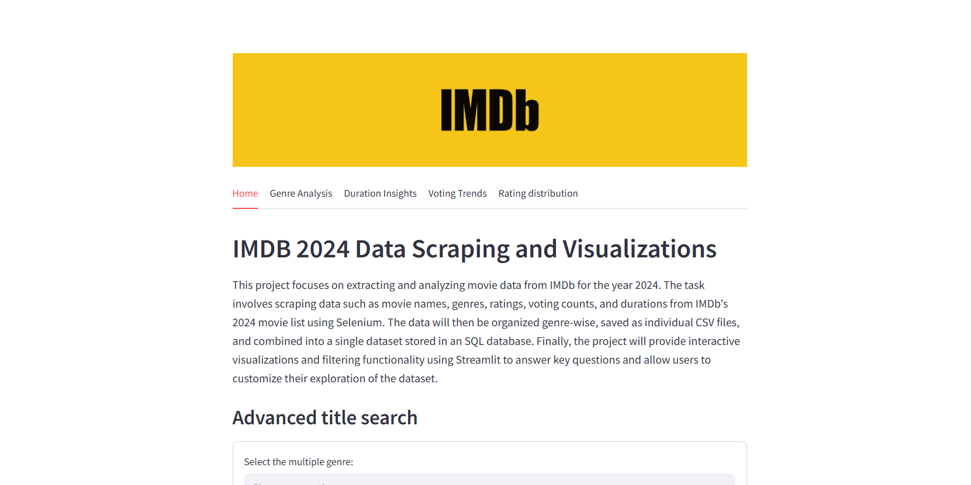
IMDb 2024 Data Scraping and visualizations
By
Shanchai Kumar S

Slide 2
Outline
Problem statement
Approach
- Data scraping
Data Organization & Storage
Data Cleaning
Visualization and Filtrations
Webpage Live Demo

Slide 3
The Problem
This project focuses on extracting and analyzing movie data from IMDb for the year 2024.
The task involves scraping data such as movie names, genres, ratings, voting counts, and durations from IMDb's 2024 movie list using Selenium.
The data will then be organized genre-wise, saved as individual CSV files, and combined into a single dataset stored in an SQL database.
Finally, the project will provide interactive visualizations and filtering functionality using Streamlit to answer key questions and allow users to customize their exploration of the dataset.

Slide 4








Technologies Used

Slide 5
Approach
Data Scraping
Data Cleaning
2
4
1
3
Data Organization & Storage
Visualization and Filtrations

Slide 6
Data Scraping
Scrapes IMDb Data – Extracts movie data from a specified IMDb URL using Selenium WebDriver to interact with the webpage.
Uses Selenium WebDriver – Automates web interactions to extract movie information dynamically.
Organizes by Genre – Stores movie details in a genre_data dictionary, where keys are genres and values are lists of dictionaries containing movie details.
Structures Data for Processing – The scraped data is categorized by genre, making it easier to save or analyze later.

Slide 7
Data Organization & Storage
Creates Directory – The function ensures the directory 'IMDB_2024_Genres_Data' exists to store genre-specific CSV files.
Saves Movies by Genre – Iterates through the genre_data dictionary, converts each genre's movie list into a pandas DataFrame, and saves it as a CSV file.
Finds CSV Files – Uses glob to locate all CSV files in the specified directory.
Merges Data – Reads each CSV file and concatenates them into a single pandas DataFrame for further analysis.

Slide 8
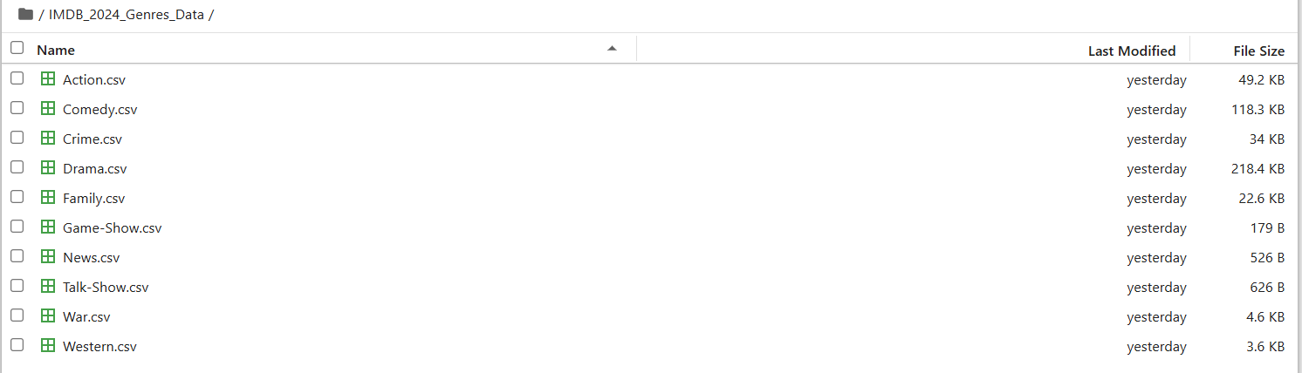
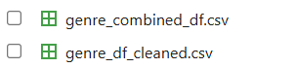
Genre wise sample datasets
Here is the final combined and cleaned dataset, structured and ready for analysis

Slide 9
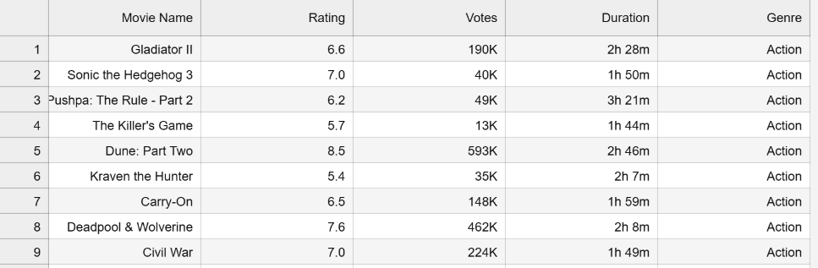
Sample Uncleaned dataset

Slide 10
Data Cleaning
Cleans the DataFrame – Reads the combined CSV file, drops missing values, resets the index, and removes duplicate rows for unique records.
Formats 'Votes' Column – Replaces 'K' with 'e3' and 'M' with 'e6' for scientific notation, displays it as a string, and converts it to an integer using pd.to_numeric().
Processes 'Duration' Column – Extracts hours and minutes separately using regular expressions, converts them to integers, and calculates the total duration in minutes.
Ensures Data Consistency – Modifies the DataFrame (new_df) for structured numeric processing, making it ready for further analysis.

Slide 11
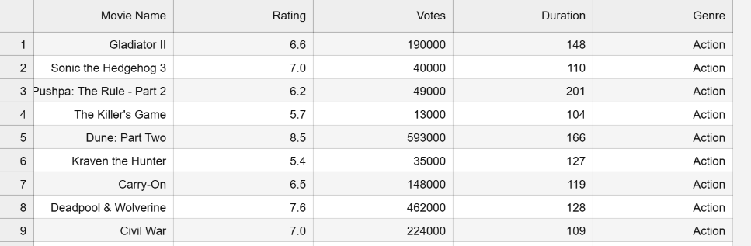
Sample Cleaned datasets

Slide 12
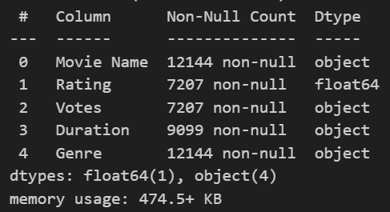
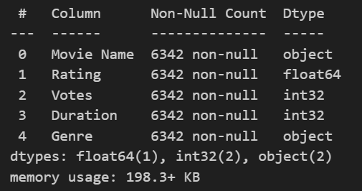
Before Cleaning Datasets
After Cleaning Datasets
VS
It highlights the changes in data types and file size after processing. By converting columns like 'Votes' to numeric and restructuring 'Duration', the dataset becomes more efficient for analysis.
The datatype transformations optimize memory usage and improve processing speed.

Slide 13
SQL Database Connection
Connects to MySQL – Uses SQLAlchemy engine to establish a connection with the database.
Reads Cleaned Data – Loads the preprocessed dataset from a CSV file into a pandas DataFrame.
Stores Data in MySQL – Pushes the DataFrame into the 'movie data' table, replacing it if it already exists.
Closes Connection – Ensures the database connection is properly closed after the operation is complete.

Slide 14
Visualization and Filtrations
Analyzes and visualizes IMDb 2024 movie data, retrieved from a MySQL database, with interactive filtering and insights.
Key Modules –
streamlit: For creating the web application interface.
pandas: For data manipulation and analysis.
seaborn: For creating visualizations.
time: For adding delays in the application.
matplotlib.pyplot: For creating plots.
sqlalchemy: For connecting to the MySQL database.

Slide 15
Continued
Main Tabs:
Home – Filters movies by genre, rating, duration, and votes.
Genre Analysis – Explores movie distribution, average ratings, and votes across genres.
Duration Insights – Examines movie duration trends and their impact on ratings.
Voting Trends – Studies the relationship between movie duration and voting count.
Rating Distribution – Analyzes rating trends and visualizes data by genre.

Slide 16
Webpage Live Demo

